Slide 1
Wilderness Survival Merit Badge
Troop 344 and 9344
Pemberville, OH

Slide 2
Wilderness Survival Merit Badge Requirements
Do the following:
Explain to your counselor the hazards you are most likely to encounter while participating in wilderness survival activities, and what you should do to anticipate, help prevent, mitigate, or lessen these hazards.
Show that you know first aid for and how to prevent injuries or illnesses likely to occur in backcountry settings, including hypothermia, heat reactions, frostbite, dehydration, blisters, insect stings, tick bites, and snakebites.
From memory list the seven priorities for survival in a backcountry or wilderness location. Explain the importance of each one with your counselor.

Slide 3
Wilderness Survival Merit Badge Requirements
Describe ways to avoid panic and maintain a high level of morale when lost, and explain why this is important.
Describe the steps you would take to survive in the following exposure conditions:
Cold and snowy
Wet
Hot and dry
Windy
At or on the water
Put together a personal survival kit and be able to explain how each item in it could be useful.
Using three different methods (other than matches), build and light three fires.

Slide 4
Wilderness Survival Merit Badge Requirements
Do the following:
Show five different ways to attract attention when lost.
Demonstrate how to use a signal mirror.
Describe from memory five ground-to- air signals and tell what they mean.
Improvise a natural shelter. For the purpose of this demonstration, use techniques that have little negative impact on the environment. Spend a night in your shelter.
Explain how to protect yourself from insects, reptiles, bears, and other animals of the local region.
Demonstrate three ways to treat water found in the outdoors to prepare it for drinking.

Slide 5
Wilderness Survival Merit Badge Requirements
Show that you know the proper clothing to wear while in the outdoors during extremely hot and cold weather and during wet conditions.
Explain why it usually is not wise to eat edible wild plants or wildlife in a wilderness survival situation.

Slide 6
Requirement 1
Do the following:
Explain to your counselor the hazards you are most likely to encounter while participating in wilderness survival activities, and what you should do to anticipate, help prevent, mitigate, or lessen these hazards.
Show that you know first aid for and how to prevent injuries or illnesses likely to occur in backcountry settings, including hypothermia, heat reactions, frostbite, dehydration, blisters, insect stings, tick bites, and snakebites.

Slide 7
1a. Hazards in the Wilderness
Commonsense ways to increase your safety and your enjoyment of outdoor adventures are covered in the seven points of the BSA’s Trek Safely plan:
Qualified Supervision. Whenever planning a trek, make sure your group includes a mature, conscientious adult at least 21 years old who understands the potential risks involved in the trip and can take responsibility for the group’s safety. One additional adult who is at least 18 years old must also accompany the group.
Keep Fit. You can train for a trip in the outdoors just like any other athletic event. Start slowly, gradually increasing the duration and intensity of your workouts, to build your physical fitness and stamina. Staying in good shape helps keep you ready for the physical demands of a trek.

Slide 8
1a. Hazards in the Wilderness
Plan Ahead. Any trip you plan should match the skill level and fitness of the members of your group. Remember to get permission from the land owner if you plan to cross or use private land, and research the terrain, elevation ranges, trails, wildlife, campsites, typical weather conditions, and environmental issues for the period of the trek. Know where you’re going and what to expect.
Gear Up. Before you leave, get topographic maps and current trail maps for the area. Take equipment—including a first-aid kit—and clothing that is appropriate for the weather and is in good condition. Wear proper protection against the sun and biting insects and animals, and remember to adjust clothing layers to match the weather conditions. Drink plenty of water to stay hydrated.

Slide 9
1a. Hazards in the Wilderness
Communicate Clearly and Completely. Communication is key to a safe outdoor adventure, and staying in touch with home base is the first step. Complete a trip plan and share the details of your trek with someone back home.
Monitor Conditions. The leaders are responsible for making good decisions during the trip, based on their knowledge of the group’s abilities. Keep an eye on weather conditions before and during the trip, and continually monitor your food and water, the group’s morale, and their physical condition. Don’t enter into a dangerous situation.
Discipline. Make sure everyone in your group understands the rules and procedures for safe trekking. When participants know the reasons behind the rules, they are much more likely to follow them.

Slide 10
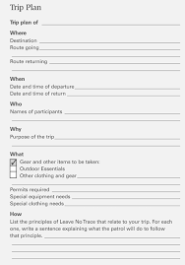
1a. Trip Plan
A trip plan answers five questions, each beginning with the letter W:
Where are we going and by which route?
When will we return?
Who is going along?
Why are we going?
What are we taking with us?
A copy of your trip plan should be left back home with one or more persons who are responsible, reliable, and available.
If you don’t return as scheduled, those back home can alert search-and-rescue personnel and give them a good idea where to start looking for you.

Slide 11
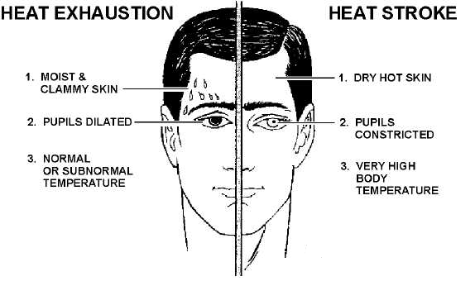
1b. Heat Emergencies

Slide 12
1b. Heat Exhaustion Symptoms
Heavy sweating
Thirst
Fatigue
Heat cramps
Headache
Dizziness
Nausea
Vomiting

Slide 13
1b. First Aid for Heat Exhaustion
Move victim from heat to rest in a cool place.
Loosen or remove unnecessary clothing.
Give water or a sports drink.
Raise feet 8-12 inches.
Put cool, wet cloths on forehead and body – spray skin with water.
Seek medical care if victim’s condition worsens or does not improve within 30 minutes.

Slide 14
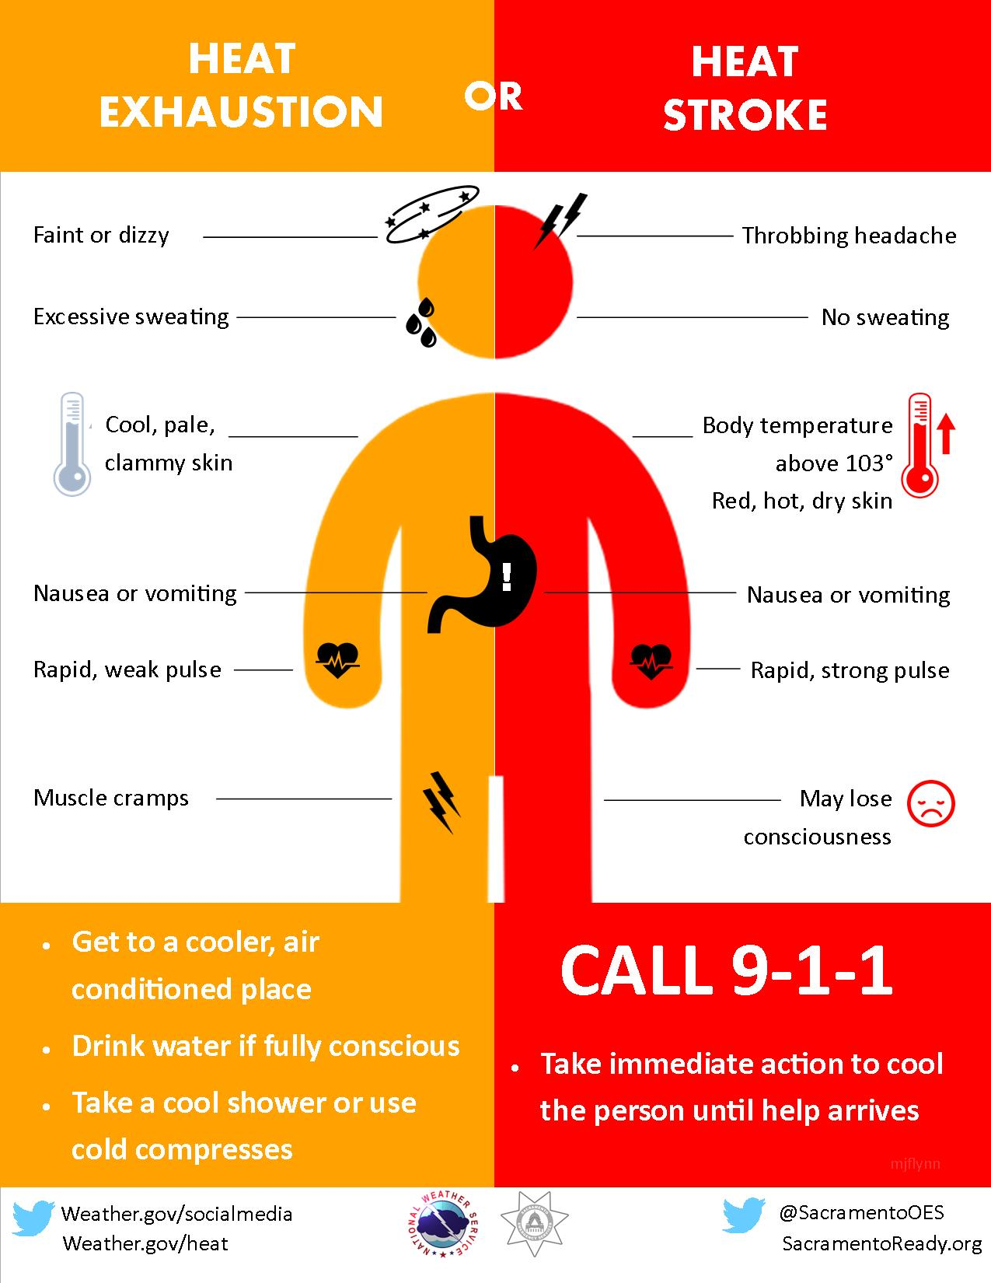
Heatstroke

Slide 15
1b. First Aid for Heat Stroke
Call 911.
Move victim to cool place.
Remove outer clothing.
Cool victim quickly.
Apply cold compresses or spray skin with water.
Put ice bags or cold packs beside neck, armpits, and groin.

Slide 16
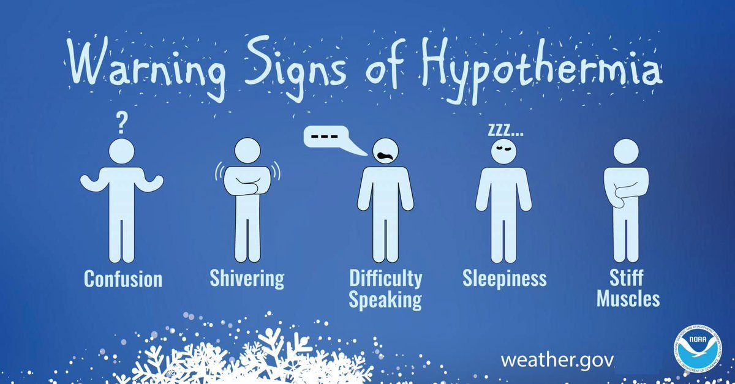
1b. Hypothermia
Occurs when body cannot make heat as fast as it loses it.
Internal body temperature drops below 95ºF.
Can occur whenever and wherever a person feels cold, including indoors in poorly heated areas.

Slide 17
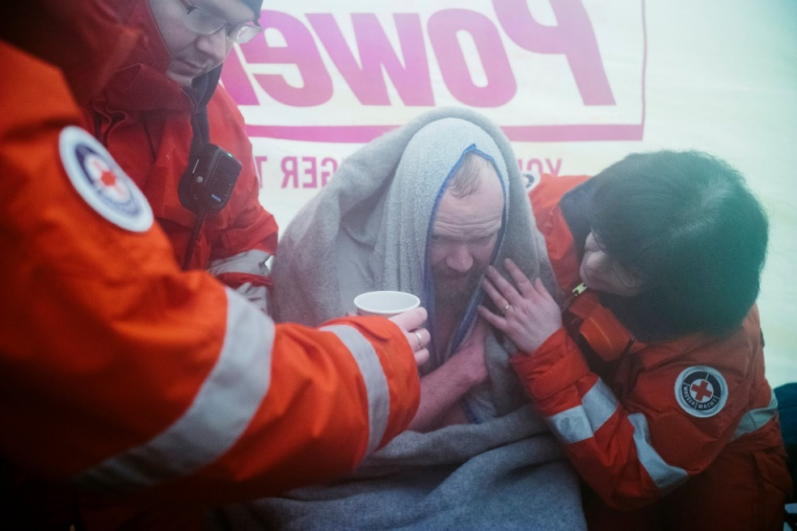
1b. First Aid for Hypothermia
Move victim to shelter.
Remove wet clothing and wrap victim in warm covers.
Apply direct body heat.
Re-warm neck, chest, abdomen, and groin first.
Give warm, sweet drinks if conscious.
Monitor breathing, administer CPR.
Get medical help.

Slide 18
1b. Frost Nip
Frost nip is an earlier and milder case of frostbite. Usually the ears, cheeks, nose, fingers and toes are affected.
Skin white or numb.
Don’t rub – hold against a warm body part.
Change clothing and/or environment.
Frost nip is a warning that you are not keeping warm enough!

Slide 19
1b. Frostbite
Mild Frostbite:
Skin looks waxy and white, gray, yellow, or bluish.
Area is numb or feels tingly or aching
Severe Frostbite:
Area feels hard.
May become painless
After warming, area becomes swollen and may blister.

Slide 20
1b. First Aid for Frostbite
Move victim to warm environment.
Hold frostbitten area in hands to warm – do not rub.
Remove any tight clothing or jewelry around area.
Put dry gauze or fluffy cloth between frostbitten fingers or toes.
Do not use heat lamp, campfire, or heating pad to rewarm.
Seek medical attention immediately.

Slide 21
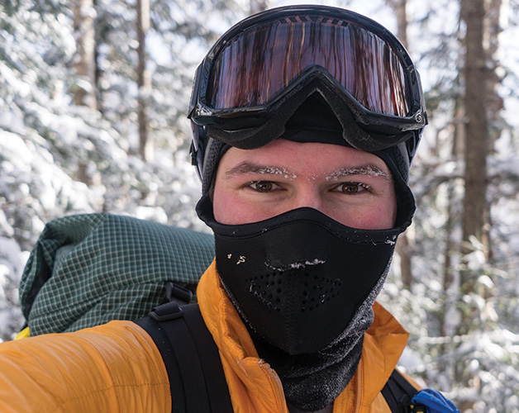
1b. Prevention of Frostbite
Be sure you dress in layers for cold weather. The first layer should be thermal underwear, and the outer layer needs to be waterproof. The layers should be loose, not tight. Mittens are warmer than gloves.
You should wear a hat. Over 50% of a your body heat is lost from the head.
Set limits on the time spent outdoors when the wind-chill temperature falls below 0°F (-18°C).
Recognize the earliest warnings of frostbite. Tingling and numbness are reminders that your are not dressed warmly enough for the weather and needs to go indoors.

Slide 22
1b. Dehydration
When the body puts out more liquid than it is taking in.
Ways we lose fluids:
Sweating.
Urination.
Vomiting.
Signs of dehydration:
Thirst.
Yellow or dark urine.
Dry mouth.
Lightheadedness.
Nausea and vomiting.
Dry skin.
Cease sweating.
Treatment:
Drink fluids (water, Gatorade).
Avoid physical activity.
Get inside air conditioned or cool area.

Slide 23
1b. Blisters
A blister is skin injury that is usually filled with water.
Blisters commonly occur on the feet or hands.
They are most often caused by the hands or feet rubbing against something (such as wearing new shoes).

Slide 24
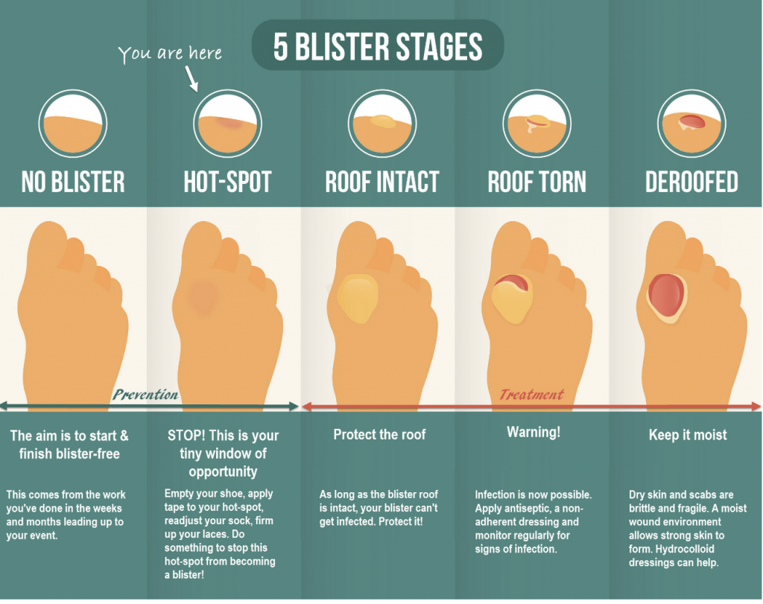

Slide 25
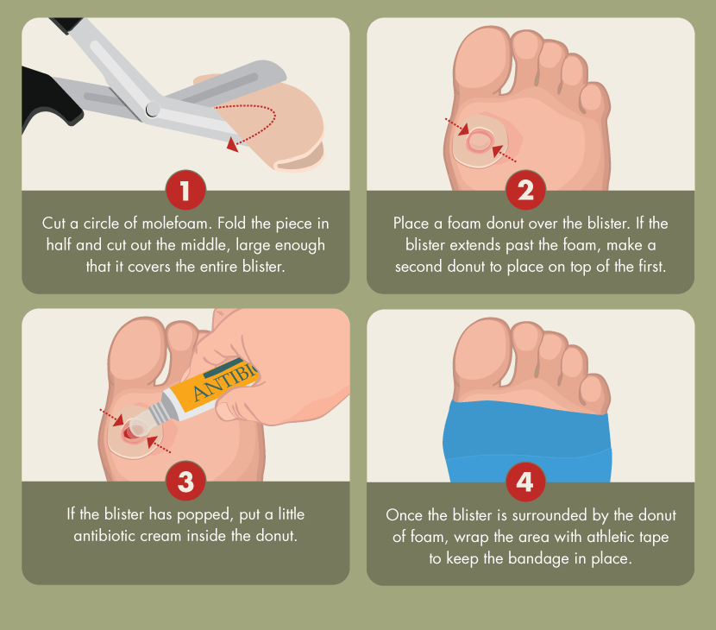
1b. Treatment for Blisters
Do not open the blisters, since this increases the possibility of infection.
Clean the skin around it.
Take the pressure off the area by placing a Band-Aid over the blister or Moleskin with a hole cut in the center.
If the blister accidentally breaks open, trim off the loose skin.
Keep the surface clean by washing it twice a day with an antibacterial soap (such as Dial or Safeguard).
Apply an antibiotic ointment and a Band-Aid to help with healing.

Slide 26
1b. Popping a Blister
If a blister is in a frequently used area that has a high risk of rupturing, it may be best to pop it to make sure it’s properly protected against infection.
Wash your hands and the blister thoroughly.
Disinfect a needle with alcohol.
Carefully puncture the blister.
Poke three or four shallow holes around the edge of the blister.
You want to keep as much of the skin intact as possible.
Allow the fluid to drain out.
Cover the blister with a first aid ointment such as Neosporin.
Apply a dressing.
Cover the blister tightly with a bandage or gauze.
Repeat if necessary.
You may need to perform these steps every six to eight hours for the first 24 hours.
After that, change the dressing and apply ointment daily.

Slide 27
1b. Preventing Blisters
Friction can also be reduced by wearing two pairs of socks.
Place Moleskin on sensitive areas were the friction may occur.

Slide 28
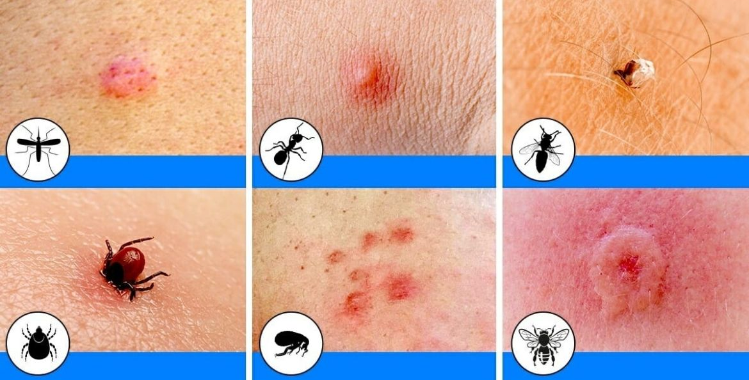
1b. Insect Bites
Bites of mosquitoes and chiggers (harvest mites usually cause itchy, red bumps. The size of the swelling can vary from a dot to a half inch.
Signs that a bite is from a mosquito are: itchiness, a central raised dot in the swelling, a bite on skin not covered by clothing, and summertime,
Bites from horseflies, deerflies, gnats, fire ants, harvester ants, blister beetles, and centipedes usually cause a painful, red bump.
Fire ant bites change to blisters or pimples within a few hours.

Slide 29
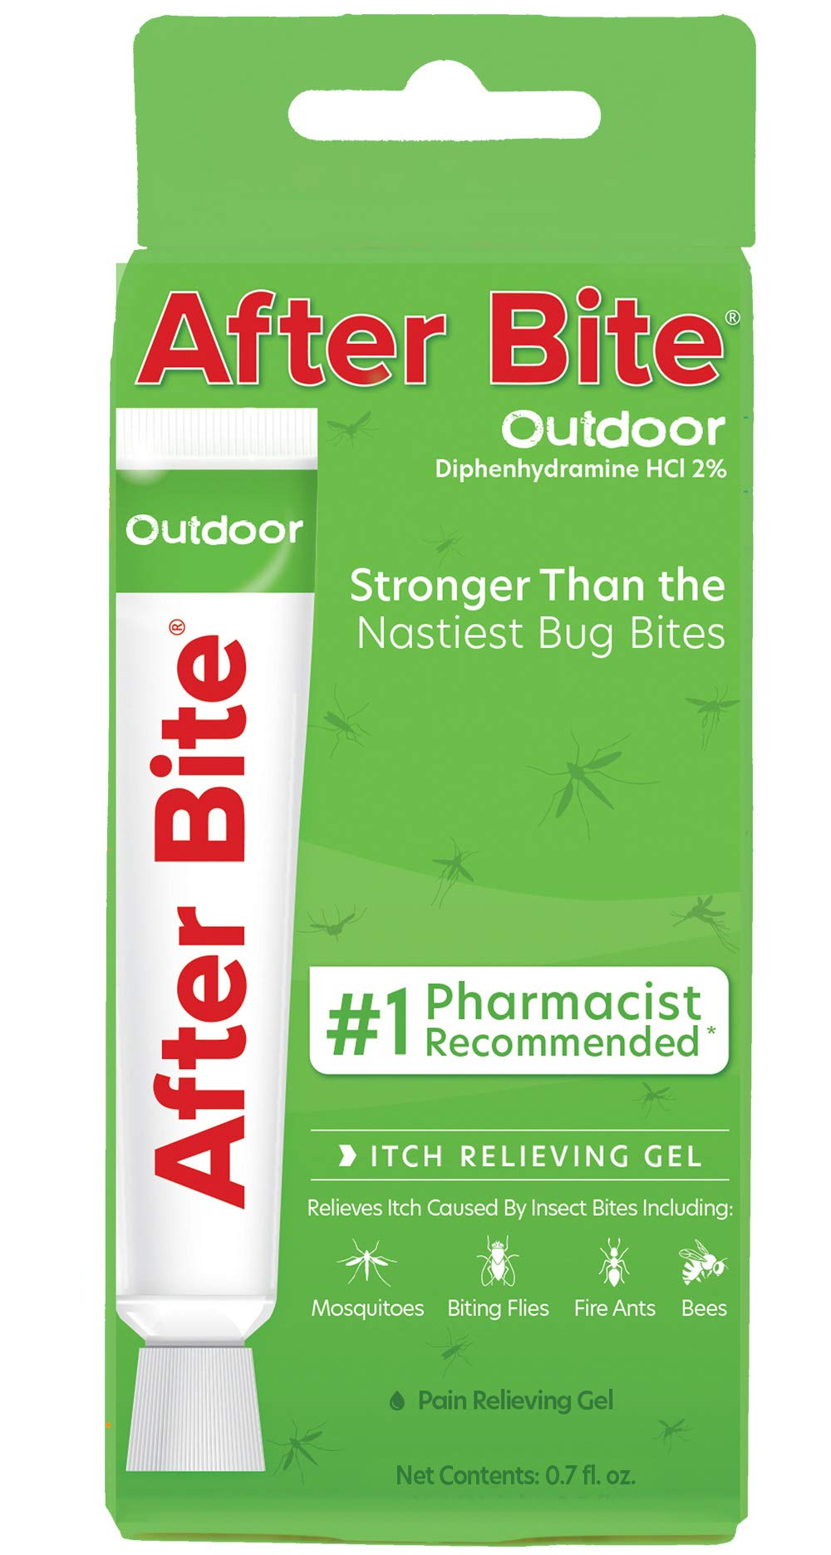
1b. Treatment of Insect Bites
Apply calamine lotion or a baking soda paste to the area of the bite.
If the itch is severe (as with chiggers), apply nonprescription 1% hydrocortisone cream four times a day.
Do not to pick at the bites or they can become infected or leave scars.
Cold, moist compresses or ice on the area can help.

Slide 30
1b. Tick Bites
Can transmit Rocky Mountain spotted fever or Lyme disease.
Tick embeds its mouth parts in skin and may remain for days sucking blood.

Slide 31
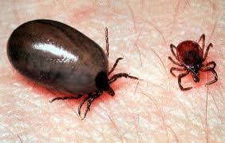
1b. Engorged Tick

Slide 32
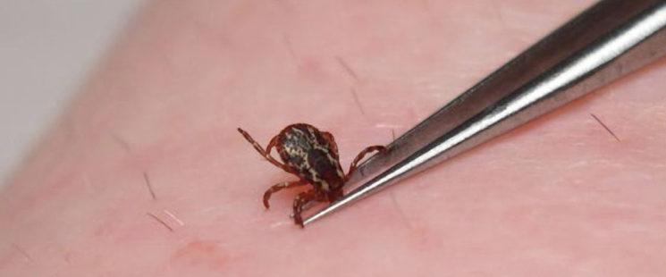
1b. Tick Removal
Grasp the tick’s mouthparts against the skin, using pointed tweezers.
Pull steadily without twisting until you can ease the tick head straight out of the skin.
DO NOT squeeze or crush the body of the tick.
DO NOT apply substances such as petroleum jelly, nail polish, or a lighted match to the tick while it is attached.

Slide 33
1b. Tick Removal (cont.)
Once you have removed the tick, wash the wound site and your hands with soap and water, and apply rubbing alcohol or antiseptic to the site.
Observe the bite over the next two weeks for any signs of an expanding red rash or flu-like symptoms (Lyme Disease).
Lyme Disease Rash

Slide 34
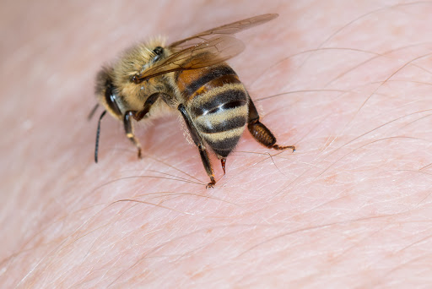
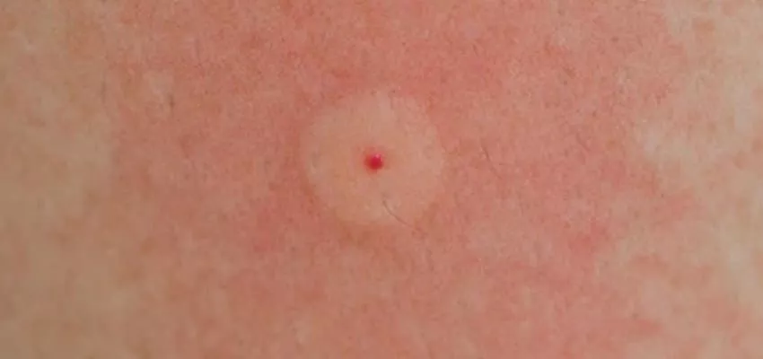
1b. Bee Stings
Honey bees, bumble bees, hornets, wasps, and yellow jackets can all sting.
These stings cause immediate painful red bumps.
While the pain is usually better in 2 hours, the swelling may increase for up to 24 hours.

Slide 35
1b.Treatment of Stings
If you see a little black dot in the bite, the stinger is still present (this only occurs with honey bee stings).
Remove it by scraping it off with a credit card or something similar.
For persistent pain, massage with an ice cube for 10 minutes.
Give acetaminophen immediately for relief of pain and burning.
For itching, apply hydrocortisone cream.

Slide 36
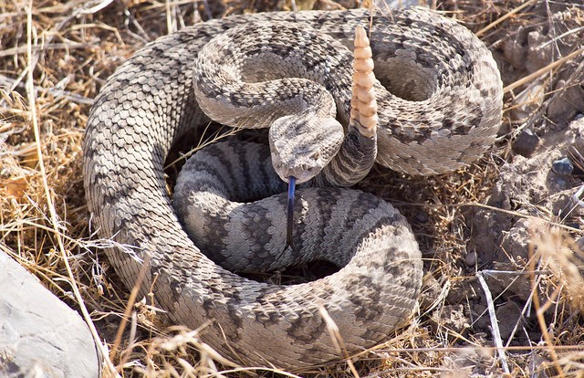
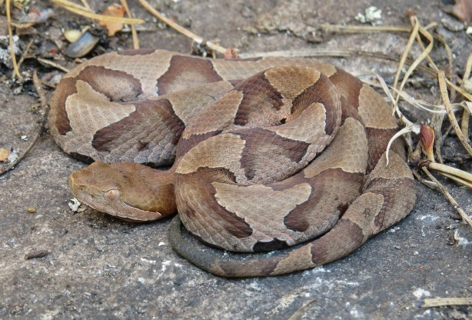
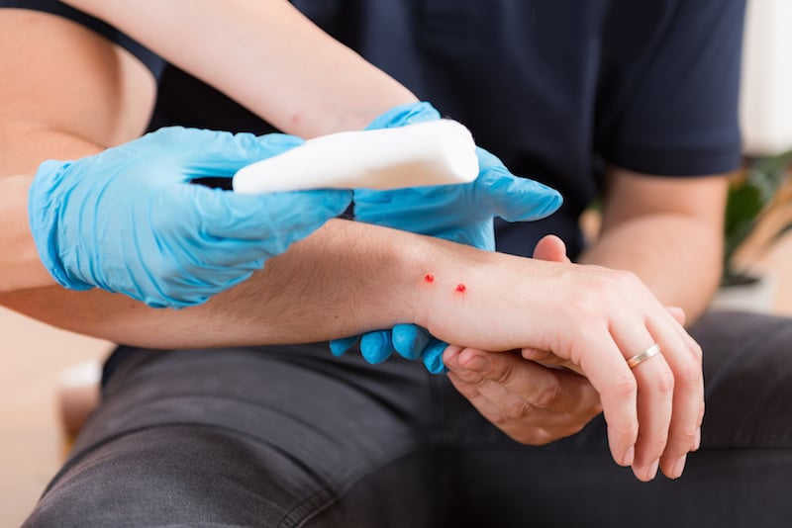
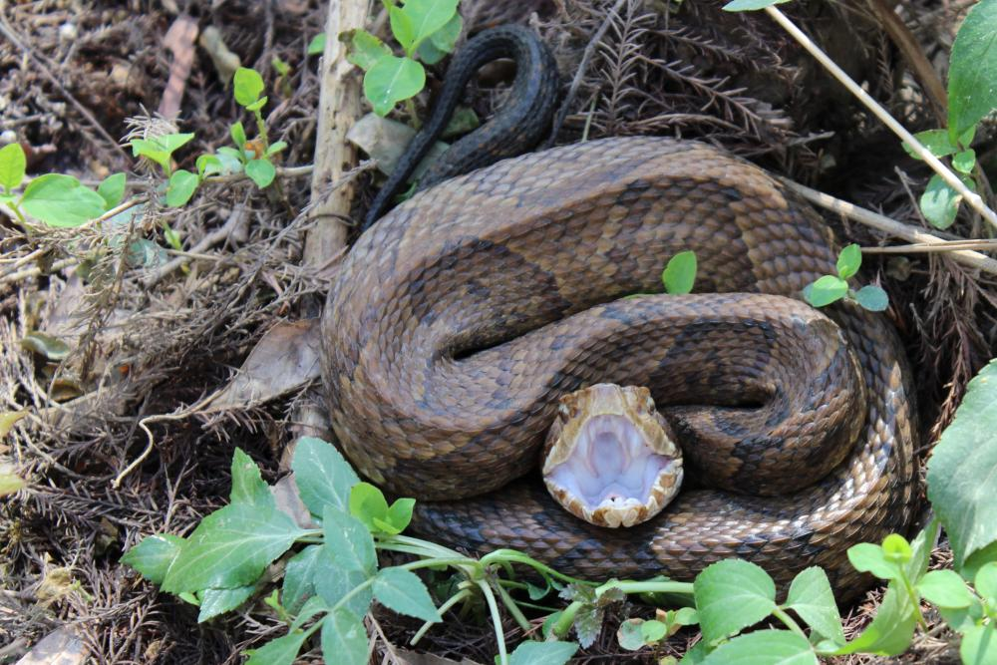
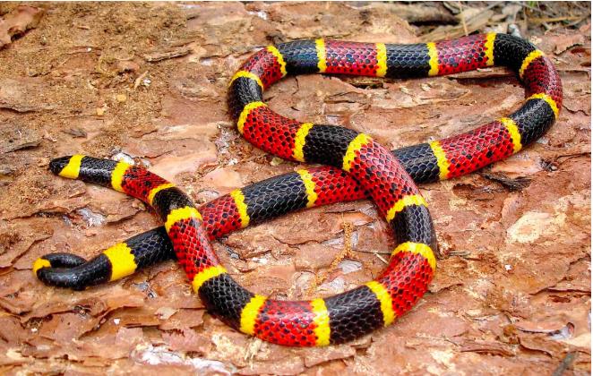
1b. Poisonous Snakebite
In the U.S. the poisonous snakes are rattlesnakes, copperheads, cottonmouths, and coral snakes.
Currently about 8,000 people per year in the U.S. are bitten by a poisonous snake, of which about 6 will die.

Slide 37
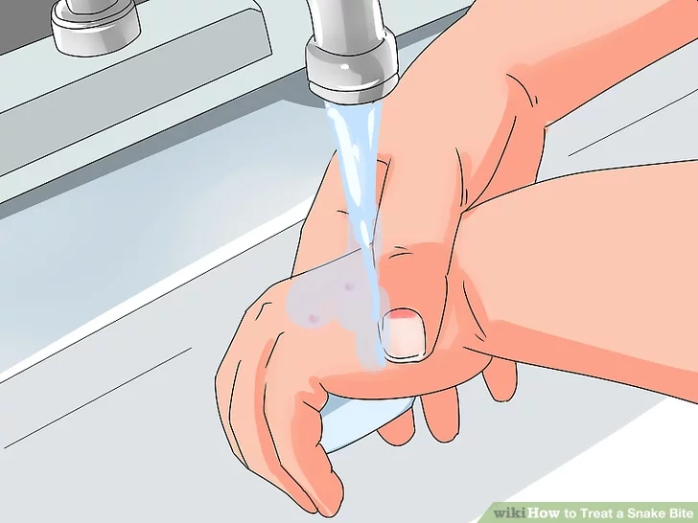
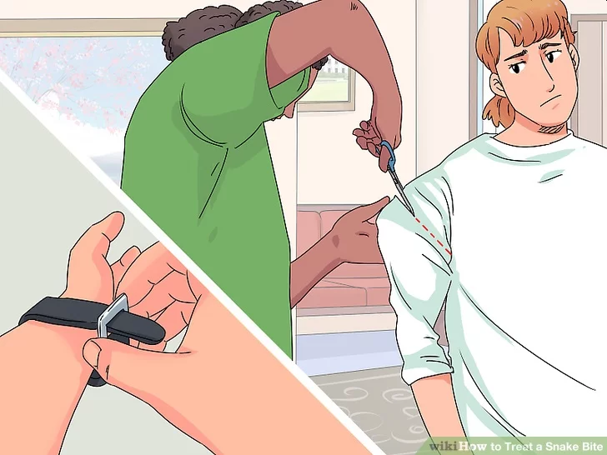
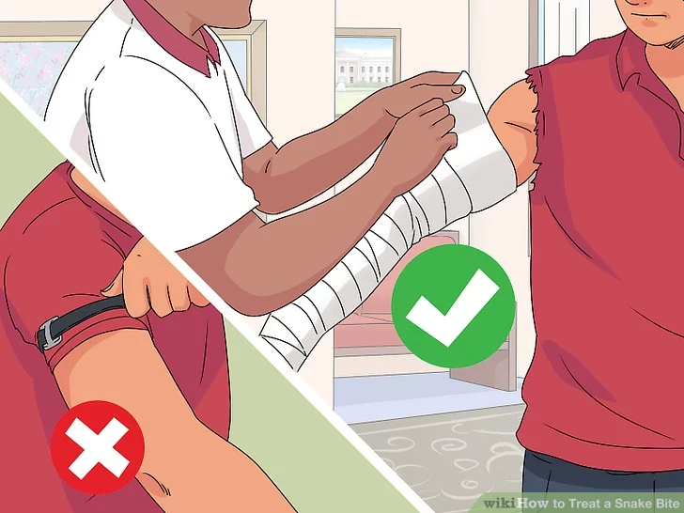
1b. First Aid for Poisonous Snake Bites
Have victim lie down and stay calm.
Keep bitten area immobile and below level of heart.
Call 911.
Wash bite wound with soap and water.
Remove jewelry or tight clothing before swelling.
Do not try to catch snake but note appearance.
If possible, wrap entire extremity with elastic (compression) bandage to slow spread of venom.
Do not use a tourniquet.
Do not cut wound open to try to drain or suck venom out.

Slide 38
Requirement 2
From memory list the seven priorities for survival in a backcountry or wilderness location. Explain the importance of each one with your counselor.

Slide 39
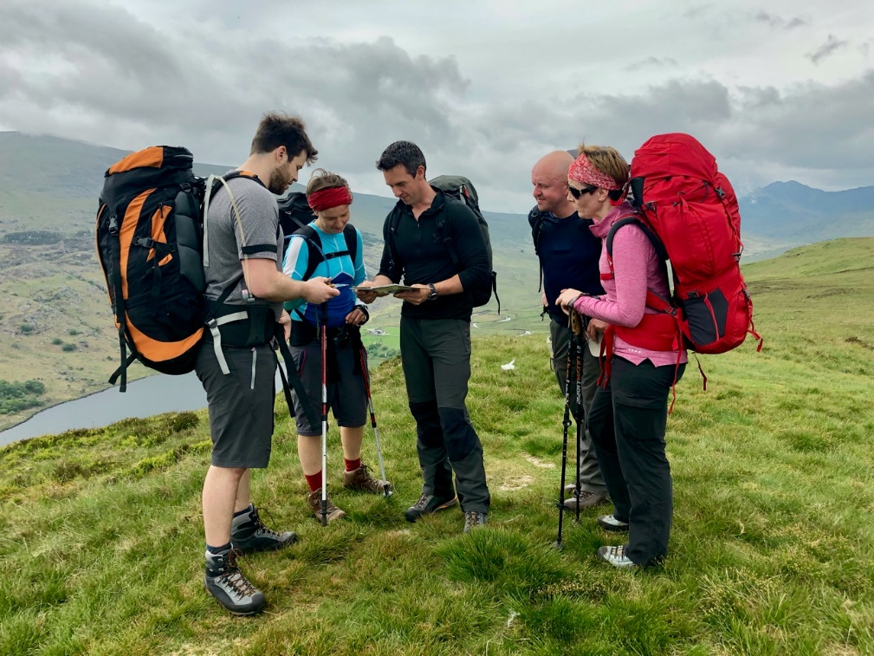
2. Seven Priorities for Survival in a Wilderness Location
STOP
Provide first aid
Seek shelter
Build a fire
Signal for help
Drink water
Don’t worry about food

Slide 40
2. Seven Priorities for Survival in a Wilderness Location
STOP
“S” is for Stop. Take a deep breath, sit down if possible, calm yourself and recognize that whatever has happened to get you here is past and cannot be undone. You are now in a survival situation and that means . . .

Slide 41
2. Seven Priorities for Survival in a Wilderness Location
STOP
“T” is for Think. Your most important asset is your brain. Use it! Don’t Panic! Move with deliberate care. Think first, so you have no regrets later. Take no action, even a foot step, until you have thought it through. Unrecoverable mistakes and injuries, potentially serious in a survival situation, occur when we act before we engage our brain. Then . . .

Slide 42
2. Seven Priorities for Survival in a Wilderness Location
STOP
“O” is for Observe. Take a look around you. Assess your situation and options. Consider the terrain, weather and resources. Take stock of your supplies, equipment, surroundings, your personal capabilities and, if there are any, the abilities of your fellow survivors.

Slide 43
2. Seven Priorities for Survival in a Wilderness Location
STOP
“P” is for Plan. Prioritize your immediate needs and develop a plan to systematically deal with the emergency and contingencies while conserving your energy. Then, follow your plan. Adjust your plan only as necessary to deal with changing circumstances.

Slide 44
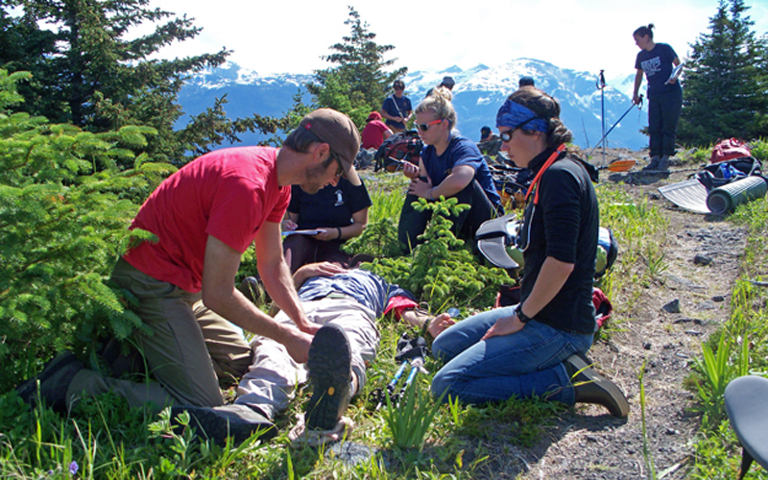
2. Seven Priorities for Survival in a Wilderness Location
Provide First Aid
Treat life-threatening injuries and illnesses immediately. As you begin putting together your survival plan, take the time to properly examine anyone who has been hurt, and decide on a course of action to care for that person.

Slide 45
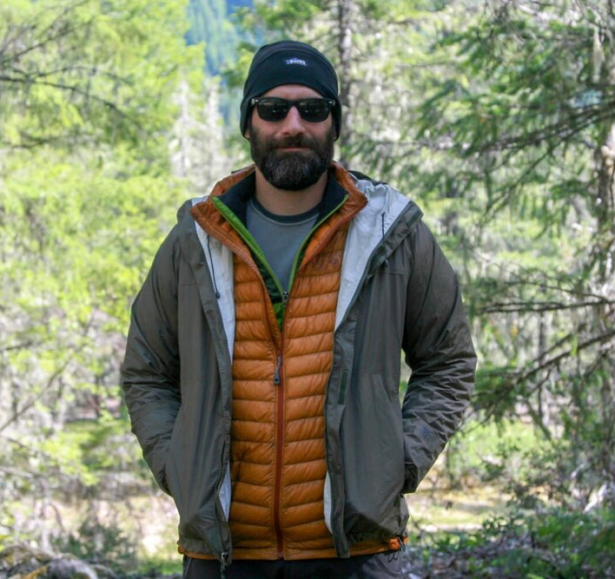
2. Seven Priorities for Survival in a Wilderness Location
Seek Shelter
Begin by assessing what you have for clothing. Rather than wearing one heavy coat, putting on layers of clothing will allow you to adjust the insulation around you to match the weather conditions you face.
Clothing insulates best when it is dry. Protect the clothing you are wearing from rain and snow by putting on any rain gear you might have or by staying under shelter.
A shelter extends the effectiveness of your clothing by adding another layer to your insulating and wind-blocking system.

Slide 46
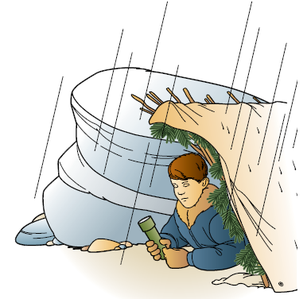
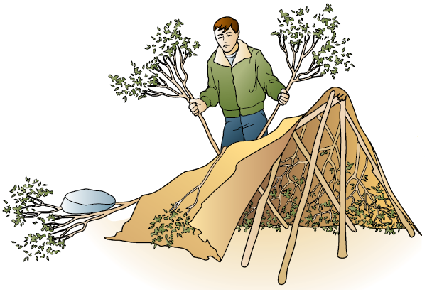
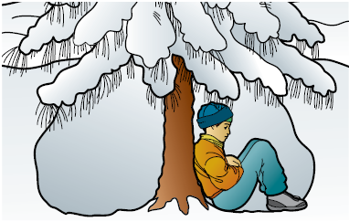
2. Seven Priorities for Survival in a Wilderness Location
Seek Shelter (continued)
Assemble a shelter that does the job but that takes as little energy as possible for you to set up.
Before building a shelter, think about how you will build it and then locate the right site for it.

Slide 47
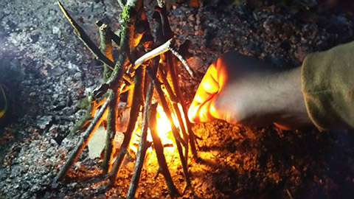
2. Seven Priorities for Survival in a Wilderness Location
Build a Fire
In chilly and cold weather, a fire can be important for maintaining body warmth, melting snow for water, drying out clothing, signaling for help, and raising your spirits.
Select a Leave No Trace Campfire Site
Fire will cause no further negative impact on the land.
Fire cannot spread from it.

Slide 48
2. Seven Priorities for Survival in a Wilderness Location
Signal for Help
Signaling for help can be very important if you have become lost or if you or others in your group are injured and cannot be moved.
Think about where you are, how you might be seen, and what you have on hand to make yourself and your location more visible to others.

Slide 49
2. Seven Priorities for Survival in a Wilderness Location
Drink Water
Drink plenty of water. You can survive for days without food, but in hot weather without water, only hours.
Dehydration happens in cold weather, too, even though you may not feel as thirsty.
The best rule is to drink plenty of water—enough so that your urine is clear—whenever you are in the outdoors.

Slide 50
2. Seven Priorities for Survival in a Wilderness Location
Don’t Worry About Food
Being hungry is not very pleasant, but on the list of survival priorities, it is not very high, either.
In general terms, the human body can go two to three days without water. As long as you stay hydrated, you can go 30 to 40 days without food of any kind.
Keeping warm in cold weather and cool in hot weather, finding shelter, drinking plenty of water, and signaling your location are all more important than finding something to eat.

Slide 51
Requirement 3
Describe ways to avoid panic and maintain a high level of morale when lost, and explain why this is important.

Slide 52
3. Avoid Panic and Maintain Morale
Avoiding Panic
Panic leads you to do irrational and dangerous things to aggravate your emergency further.
The best way for you to prepare yourself for trouble and not panic is to have plans for different contingencies - like getting lost, becoming immobilized, running out of food, etc.
If unexpected trouble comes your way, the best way to avoid panic is to evaluate your resources. What do you and your companions have with you? How can you use these items to make the most of your situation and avoid possible risks?

Slide 53
3. Avoid Panic and Maintain Morale
Keep a Positive Attitude
Many survivors of wilderness emergencies have said that a willingness to survive is the key factor in getting through a difficult situation.
You might assume that everyone has an equal desire to survive, but that is not always the case.
Some people will endure almost unbelievable conditions while others in much less difficult situations might simply give up and quit.
Make a conscious choice to be among those who can and will endure.

Slide 54
3. Avoid Panic and Maintain Morale
Keep a Positive Attitude

Slide 55
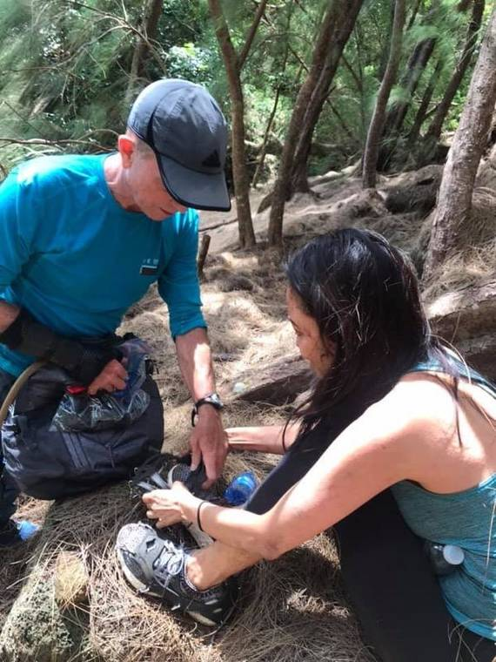
3. Avoid Panic and Maintain Morale
How to Maintain Morale
Assessment: The best way to begin with morale maintenance is to have a fair assessment of the level of morale in your group or yourself. You won't really know what you need to do until you find out what you actually need. Ask your group questions like "How are you feeling right now?" and "What are you thinking about?" Some people may not show their pain or problems, so ask.
Support: Your fellow survivors need to know that you have their back. Show your support through word and deed. Survival situations are stressful and traumatic, and people handle hardships very differently. You might not be able to have an effect on their feelings or thoughts, but show them that you are on their side anyway.

Slide 56
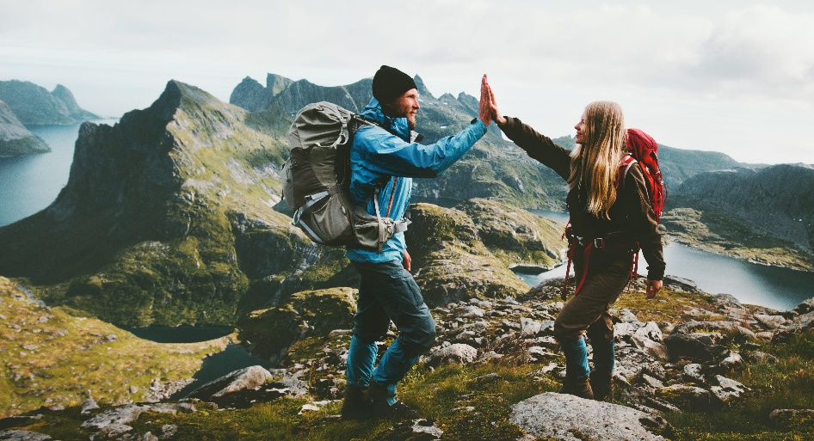
3. Avoid Panic and Maintain Morale
How to Maintain Morale
Encouragement: Unless the person has mentally or emotionally "checked out" from the situation, a few positive words can boost morale significantly. Repeat uplifting words to yourself and anyone in your company. Find something that motivates you or your group, and use that idea to bolster morale.
Reward: Find ways to reward yourself or your group. Find good things to look forward to in the short term. Celebrate even your smallest successes (or even just the absence of failure).

Slide 57
3. Avoid Panic and Maintain Morale
How to Maintain Morale
Reassess: Don't ignore or neglect morale.
Reassess the morale level every day.
Find a better morale booster than threats.
You don't have to be the class clown, but you need to keep everybody (or yourself) going until you finally make it through your ordeal.

Slide 58
Requirement 4
Describe the steps you would take to survive in the following exposure conditions:
Cold and snowy
Wet
Hot and dry
Windy
At or on the water

Slide 59
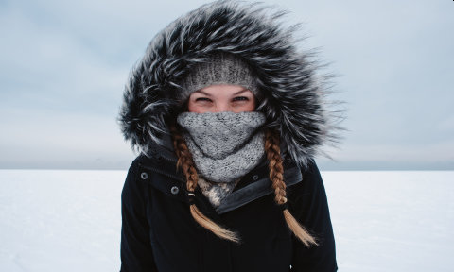
4a. Surviving Cold and Snow
Cold weather brings with it the very real danger of hypothermia.
The temperature does not need to be all that low for hypothermia to be a concern.
Do all you can to keep yourself warm and dry.
Watch those around you for signs that they are becoming chilled.

Slide 60
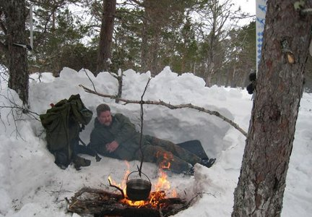
4a. Surviving Cold and Snow
Take steps to find shelter and, if possible, to light a fire.
Snow can be an effective resource for building a shelter. It may be as simple as a depression dug into a snowbank so that you can get out of the wind. With more time and energy, you might dig a snow cave or construct a snow trench to create a shelter that will insulate you from the cold.
Be sure to drink plenty of fluids even though you might not feel thirsty. Melt snow over a stove or campfire.

Slide 61
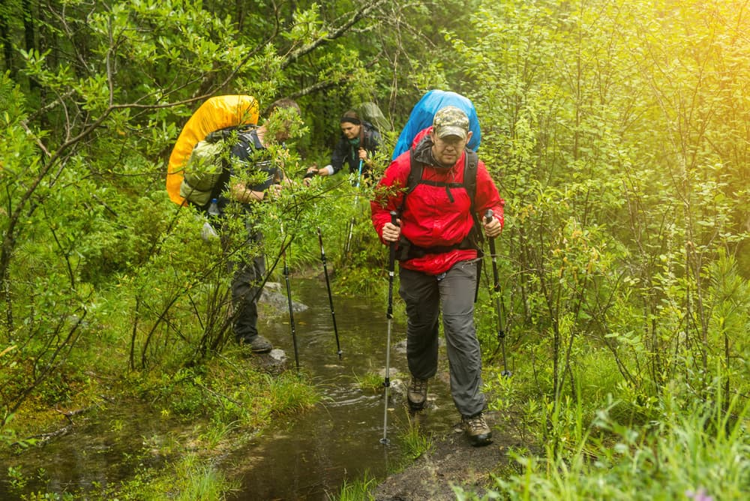
4b. Surviving Wet Conditions
While forests can offer an abundance of materials for making shelters and building campfires, they can also be challenging, especially if the weather is wet. The shade of a forest floor can feel chilly, and dampness can make it seem even colder.
As in other settings, do what you must to keep yourself and others dry and warm, and be on guard against hypothermia.
Dense forests can make signaling to rescuers difficult. You might need to move a short distance to a meadow, stream bank, or other open area visible from an aircraft.
Consider your options carefully, though, before changing locations. Mark your route clearly in case you need to find your way back.

Slide 62
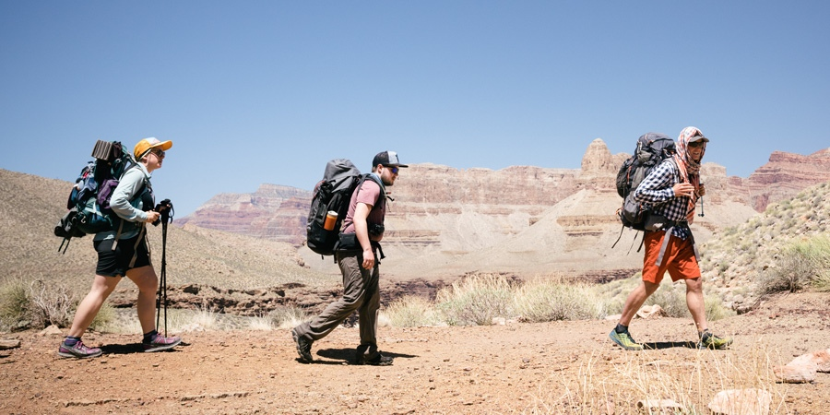
4c. Surviving Hot and Dry
While the greatest challenge of desert survival might be staying cool during the day, nights are sometimes cold enough in arid regions for you to need clothing, shelter, and perhaps a fire to keep warm.
Rest in a high, shady spot during the day, then complete necessary activities in the cool of the evening or early morning.
Wear sun protection if you have it, including long sleeves and a hat. A hat or some type of head cover will help beat the heat, too.

Slide 63
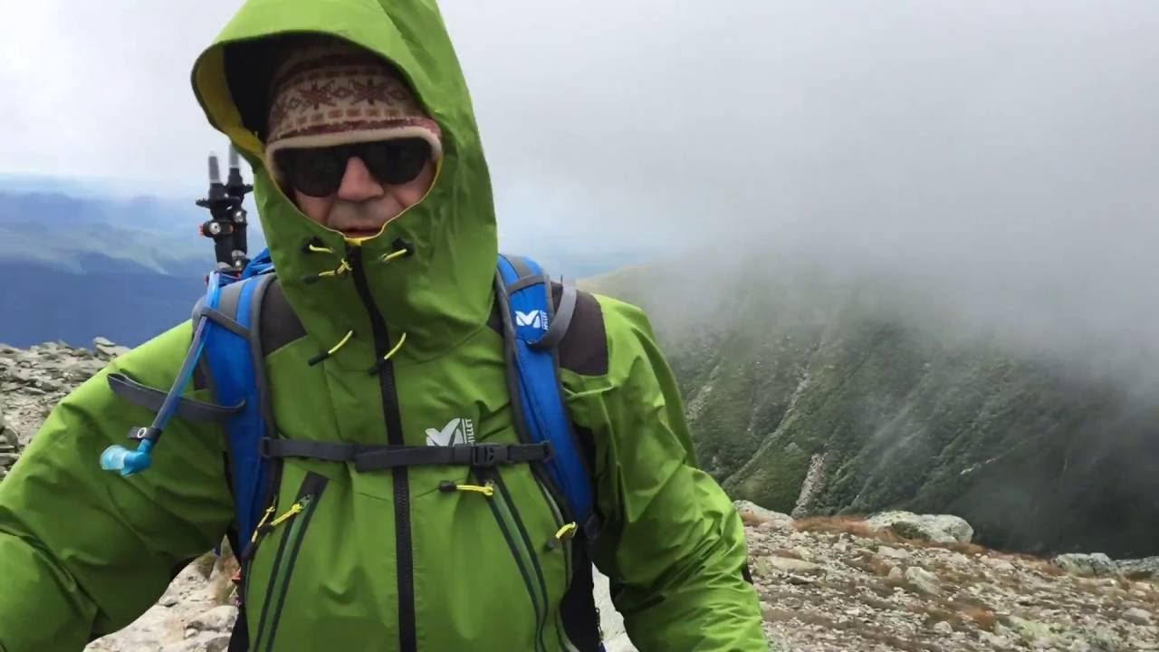
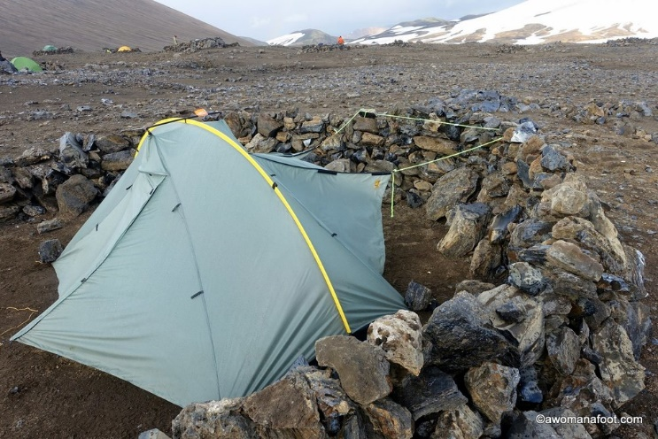
4d. Surviving Windy Conditions
Wind can make other challenges more difficult to overcome.
In hot weather, a wind might help keep you cooler, but it can also sap away moisture and cause you to need to drink water more often.
In cold weather, wind can blow warm air away from your body and cause the temperature to seem colder than what is indicated on a thermometer.
A steady wind can be exhausting as it hammers away at your energy and morale.
Protect yourself from the wind by wearing a windproof outer layer—a jacket, rain gear, or even a tarp or tent rain fly. Seek shelter on the calm side of a boulder or large tree.
If the weather is chilly or cold, watch for any signs of hypothermia.

Slide 64
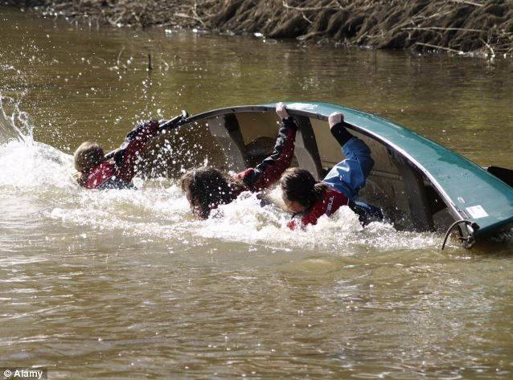
4e. Surviving At or On the Water
Emergencies on water often begin when a watercraft capsizes or when someone falls from shore or from a boat.
The first concern is to protect those in the water from drowning.
They will need to get to dry land, get back into their watercraft, or stay afloat until help arrives.
If you are in cold water very near the shore, get everyone out of the water as soon as possible to help avoid hypothermia.

Slide 65
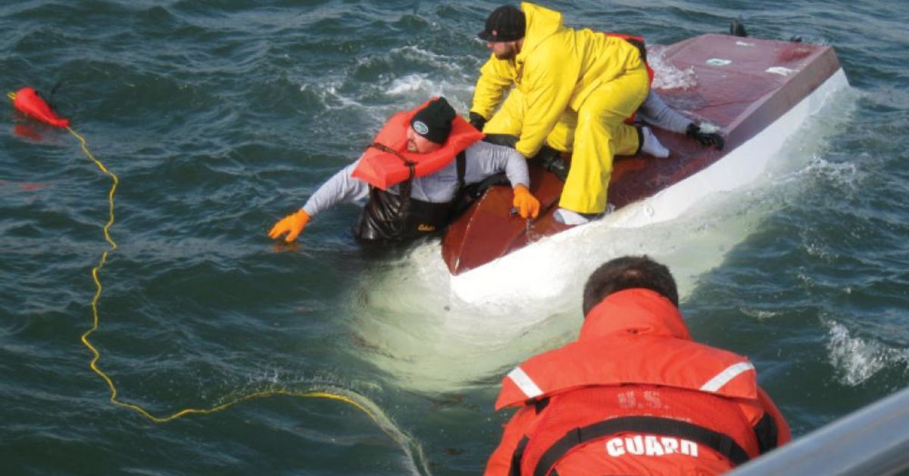
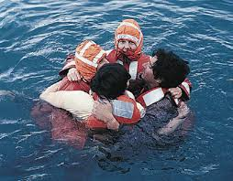
4e. Surviving At or On the Water
If you capsize far from shore, try to get as much of your body out of the water as possible by climbing on the capsized craft.
If that is not possible, conserve energy and body heat by floating with your personal flotation device and clothing on, your head positioned so that you can breathe, and your legs drawn up close to your trunk.
Huddle together with others if you are not alone.
A capsized canoe, boat, or other watercraft, even if damaged, might stay afloat. It is also more visible than a person alone in the water.
Canoes and small boats can sometimes be righted, but don’t waste much energy in the effort.

Slide 66
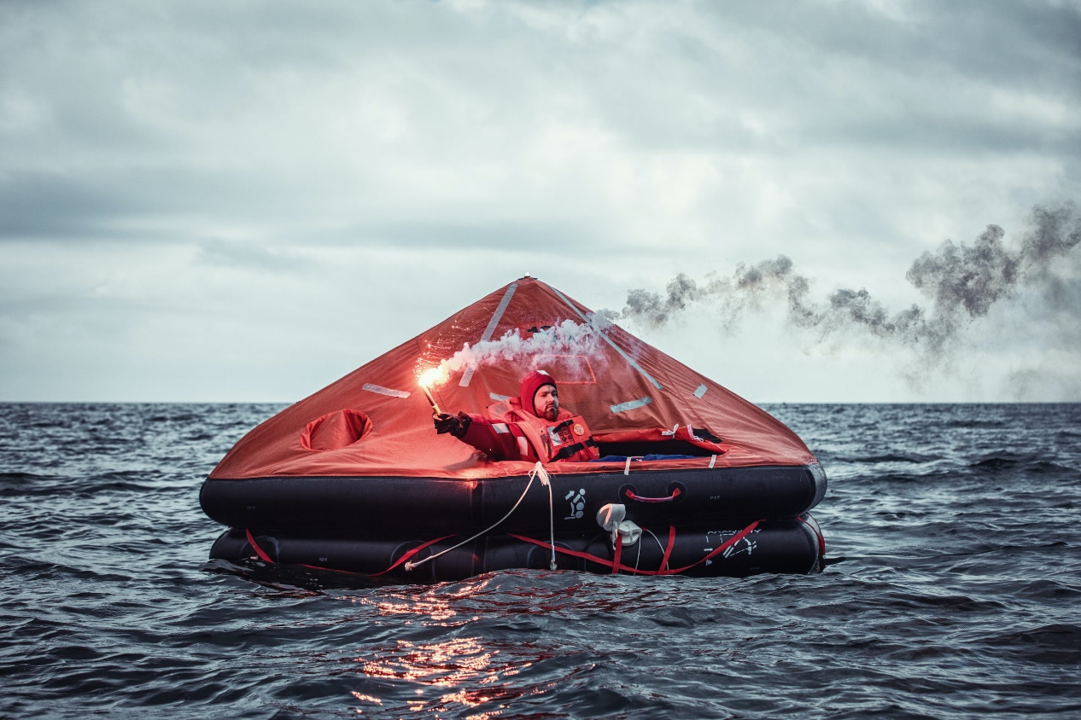
4e. Surviving At or On the Water
When a survival situation involves a life raft, look for storage compartments containing an emergency kit that might contain first-aid supplies, water, signaling devices, and emergency food. Follow the instructions included with the kit.

Slide 67
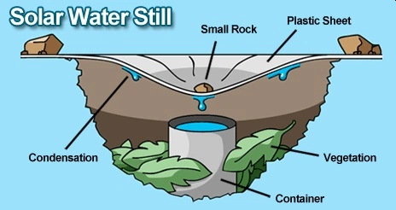
4e. Surviving At or On the Water
If you are stranded at sea or on the coastline of an ocean, don’t drink the salt water. The mineral content will cause your body to dehydrate more quickly than if you drank no seawater at all.
Instead, stay in the shade to keep from sweating away more moisture than necessary. On shore, try to locate streams, springs, and other sources of fresh water. If you are stranded on a watercraft, be ready to collect water from rain or morning dew.

Slide 68
Requirement 5
Put together a personal survival kit and be able to explain how each item in it could be useful.

Slide 69
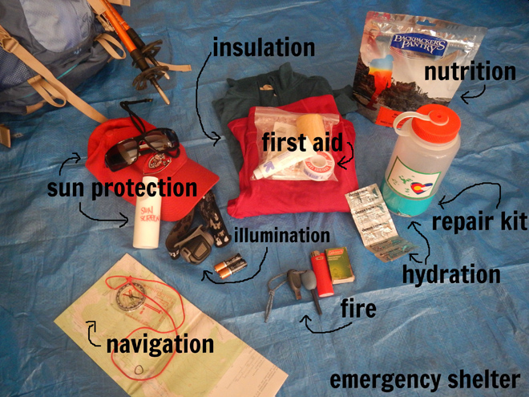
5. Personal Survival Kit
Every survival kit begins with the Outdoor Essentials. Get into the habit of having them with you on every trip into the backcountry.
❏ Pocketknife
❏ First-aid kit
❏ Extra clothing
❏ Rain gear
❏ Water bottle
❏ Flashlight
❏ Trail food
❏ Matches and fire starters
❏ Sun protection
❏ Map and compass

Slide 70
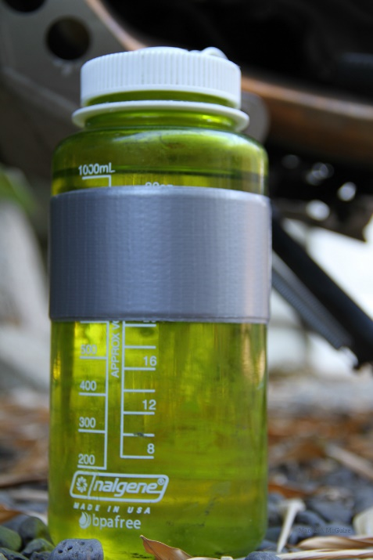
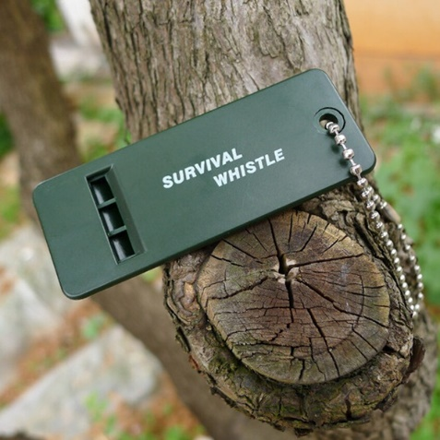
5. Personal Survival Kit
Adding some or all of the following items to your emergency kit can come in handy during survival situations.
Duct Tape. Wrap a length of it around a plastic water bottle and you will always have some handy.
Whistle. A whistle can be heard for longer distances than shouting can and requires less energy.
Signal Mirror. A metal signal mirror can be slipped into your first-aid kit or a side pocket of your pack. Keep it in its case or slip it inside a spare sock to protect it from becoming scratched and dull.

Slide 71
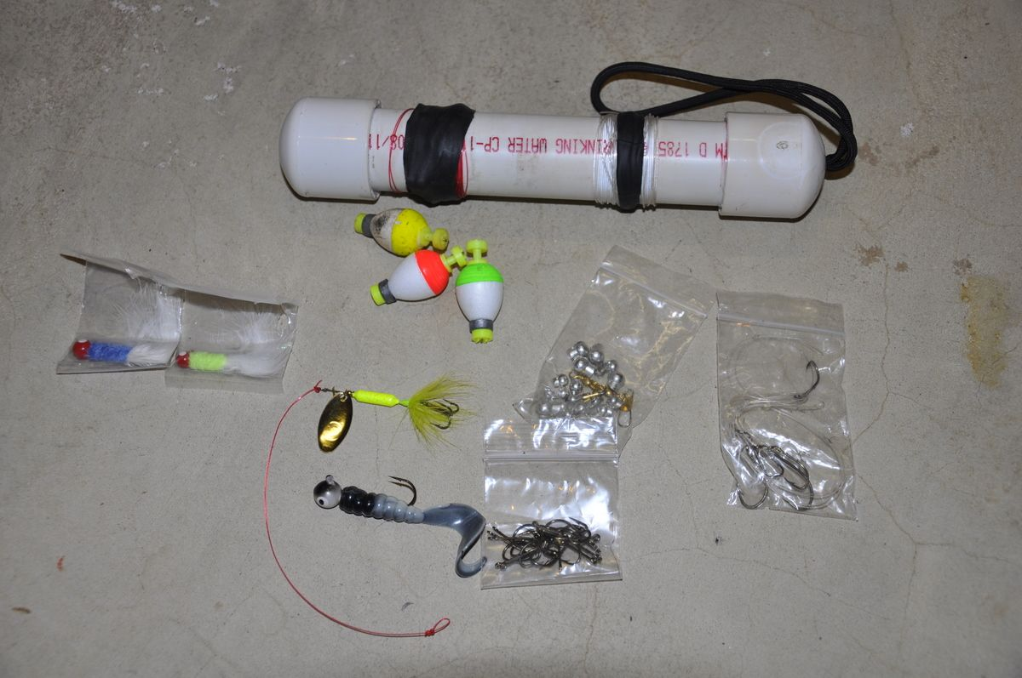
5. Personal Survival Kit
Adding some or all of the following items to your emergency kit can come in handy during survival situations.
Thin Wire. A few feet of thin wire can come in handy for repairing camping gear.
Garbage Bag. A heavy-duty 30- to 39-gallon plastic bag, preferably in a bright color, can be used for emergency rain gear, to protect tinder and kindling from the rain, and to shield your sleeping bag and other equipment.
Fishing Line and Hooks. Fifty feet of nylon fishing line can have many uses for making repairs. Add a few hooks and you will have the gear you need to try fishing in lakes and streams.

Slide 72
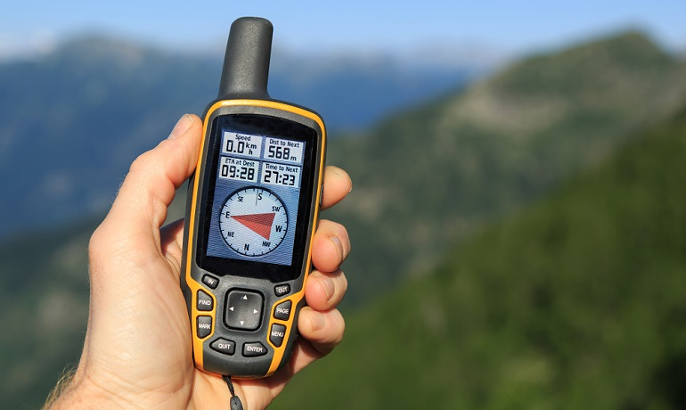
5. Personal Survival Kit
Mobile Phones and Global Positioning Receivers.
Global positioning system (GPS) receivers allow travelers to pinpoint locations, but they are no substitute for mastering the use of maps and compasses. Likewise, mobile telephones can be a convenient means for groups to contact emergency response personnel, but phones are useless if they malfunction, the batteries are exhausted, or distance and terrain prevent clear reception of signals.
Most of all, never assume that having a portable telephone, GPS receiver, or any other electronic device gives you any protection to attempt activities beyond your levels of skill and experience, especially if you are far from emergency support.

Slide 73
Requirement 6
Using three different methods (other than matches), build and light three fires.

Slide 74
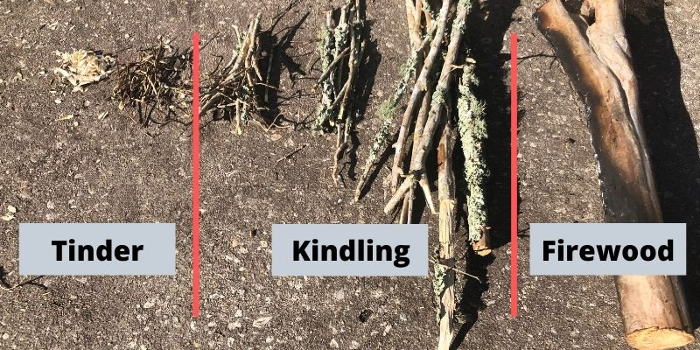
6. Lighting a Fire without Matches
Building a Fire
Begin by gathering three kinds of flammable material:
Tinder is fine, dry material that will burst into flame at the touch of a match. Pine needles, the inner bark of dead branches, weed fluff, dry grasses, and slivers shaved with a knife from a stick all are good sources of tinder.
Kindling is material that will burn with a little encouragement. Twigs no thicker than a pencil.
Fuel is dead and downed wood no bigger than your wrist that you will use to keep your blaze burning. In wet weather, look for small, dry branches near the bases of trees where larger branches above them have kept off the rain.

Slide 75
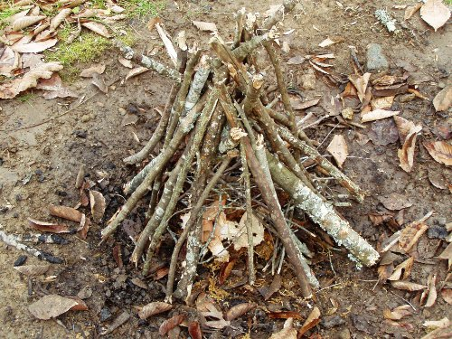
6. Lighting a Fire without Matches
Making the Fire Lay
A tepee fire lay works especially well.
Place a big, loose handful of tinder in the center of your fire site.
Mound plenty of kindling over the tinder.
Then, arrange small and medium-sized sticks of fuelwood around the kindling as if they were the poles of a tepee.
Leave an opening in the “tepee” on the side the wind is blowing against so that air can reach the middle of the fire.

Slide 76
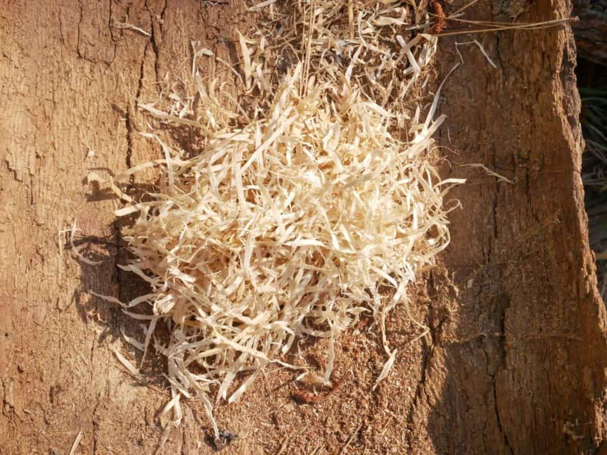
6. Lighting a Fire without Matches
Tinder for Lighting Fires Without Matches
Very fine tinder is essential for lighting fires without matches.
In the field, try shredding the dry inner bark of a cottonwood, elm, or cedar tree, or gathering the fluff from a mouse nest or chipmunk burrow.
You can use lint from a clothes dryer, too.
In survival situations, gather three or four times as much tinder, kindling, and fuel wood as you would normally want so you won’t have to run off to gather more flammable material once the fire is burning.

Slide 77
6. Lighting a Fire without Matches
Magnifying Lens.
On a clear day you might be able to focus sunlight through a curved lens such as that found on the baseplates of some compasses and in eyeglasses, a magnifying glass, camera lenses, binoculars, and telescopes.
In some cases, you might need to remove the lens from the instrument in which you found it.
Hold the lens so that the sunlight streaming through it is concentrated down to a bright pinpoint on your tinder.
In a few moments it will generate enough heat to cause the tinder to burn.

Slide 78
6. Lighting a Fire without Matches
Flint and Steel.
Striking one hard object against another can sometimes produce sparks such as a pocketknife and a piece of flint.
Form your fine tinder (dryer lint works well) into a bird’s nest shape the size of a softball.
Holding the flint just above the tinder, strike it with the steel to direct the sparks into it.
Use a downward motion to strike the steel against an edge of the flint.
Nurse a spark into a flame by blowing on it very gently.
When the tinder bursts into flame, and the kindling catches fire, push it underneath your fire lay.

Slide 79
6. Lighting a Fire without Matches
Bow and Drill -- You'll need the following items:
Socket - flat, hand-size rock with a slight depression on one side
Drill - sturdy, straight hardwood stick, 1-2 inches in diameter and a foot long
Fire Board - flat, softwood board about a foot long, 6 inches wide and one inch thick
Bow - flexible and sturdy green stick about one inch in diameter and 18-24 inches long
Cord - hiking boot laces work well
Once you've gathered your items, it's time to make some fire:
Cut a slight, round depression just inside the center edge of the fire board.
Notch a V-shaped cut on the underside of the center edge that just meets the depression.
Bend your bow stick into a half moon and tie it tight with your boot lace.
Place the board on the ground and put a cotton ball-sized bunch of tinder under the notch.
Put your foot on the board for stability and loop the bow string around the drill, resting in the round depression.
Place your socket on top of the drill with moderate pressure and saw the bow back and forth. This will twist the drill and create hot, black powder that falls onto your tinder. Before long, the tinder should ignite and you can transfer it to your fire pit.

Slide 80
6. Lighting a Fire without Matches
Battery and Steel Wool.
Get the finest steel wool you can find, #00 or #000 grade.
Use a 9V battery since the terminals are next to each other and it is simple to complete the circuit.
You can use ANY battery that you have available by pulling apart the steel wool so it can reach each end of the battery.
Get your kindling and tinder ready.
Touch the battery contacts to the steel wool to complete the circuit. The steel wool will ignite and burn. Be sure not to touch the HOT metal or breath the fumes.
Start feeding the burning steel wool with kindling and blow gently on the igniting pile as you normally would for starting a fire.

Slide 81
Requirement 7
Do the following:
Show five different ways to attract attention when lost.
Demonstrate how to use a signal mirror.
Describe from memory five ground-to- air signals and tell what they mean.

Slide 82
7a. Attracting Attention when Lost
Noise. Recognized signals of distress include three blasts on a whistle, three shouts, three bursts from a boat air horn, or three of any other sounds delivered every minute or two.

Slide 83
7a. Attracting Attention when Lost
Electronic Devices. Mobile phones are useful in areas with coverage, but many backcountry areas are out of reach of a cell tower. Before you leave, find out whether the area you will be visiting has reliable service.

Slide 84
7a. Attracting Attention when Lost
Mirrors and Lights. When the sun is shining, the flash of light reflected with a signal mirror can be seen for miles.
If you don’t have a signal mirror, you might be able to use a piece of shiny flat metal from an aircraft or remove a rearview mirror from a motor vehicle, or even use the shiny side of a CD or DVD.
At night, use a flashlight to send groups of three flashes in the direction where you believe rescuers might be able to see them.
Flares can be found on airplanes and in some watercraft and motor vehicles and can be effective if you have a rescue aircraft in sight. They are visible for only a short time, though, so save them for the right moment.

Slide 85
7a. Attracting Attention when Lost
Color and Motion. Hanging brightly colored clothing or camping gear on tree branches can catch the rescuers’ attention.
Flags, banners, and contrasting colors can be part of your signaling efforts.
If you can see rescuers, wave a shirt over your head or attach it to a pole and wave it as a flag.

Slide 86
7a. Attracting Attention when Lost
Fire and Smoke. A fire will probably already be part of your survival strategy. The light from it might attract attention at night, and smoke can be seen during the day. Experiment with ways to make a fire smoky by adding pitchy wood, damp leaves, branches, ferns, grasses, and other vegetation to the flames without actually putting out the fire.

Slide 87
7b. How to Use a Signal Mirror
Sight a target through the hole in the center of the mirror or by looking just over the mirror’s top edge.
Hold your extended arm in line with the target and adjust the angle of the mirror so that reflected light illuminates fingers of your hand raised to form a “V” through which you can see the target.
Aiming it takes practice.

Slide 88
7c. Five Ground to Air Signals
Ground-to-Air Signals. A simple set of ground-to-air signals will allow you to communicate with searchers flying overhead.
Make your symbols as big as you can.
Use whatever is on hand to construct symbols that can be seen easily from the air—rocks, overturned sod, piles of branches, and pieces of clothing and equipment.
Where snow covers the ground, use your feet to stomp out the shapes of the symbols.
Lining the shapes with branches, ashes, soil, or other dark material can make the symbols more visible.

Slide 89
Requirement 8
Improvise a natural shelter. For the purpose of this demonstration, use techniques that have little negative impact on the environment. Spend a night in your shelter.

Slide 90
8. Improvising a Natural Shelter
Building a survival shelter is an absolute priority, if you face a survival situation in harsh or unpredictable weather.
A good shelter must protect you from the elements and be comfortable enough for resting and sleeping.
Most people cannot survive unprotected from rough weather for more than a few hours.
If possible choose ground:
that is dry, well drained and reasonably flat.
that is a comfortable distance to water and has a supply of firewood.
that has building materials for your shelter.
that provides protection against strong winds.

Slide 91
8. Improvising a Natural Shelter
Unsuitable shelter sites:
A site too close to water may lead you to be troubled by insects.
Rivers presents a constant threat to safety. Heavy rainfall in nearby hills can easily create flash floods. Avoid dry riverbeds.
Avoid loose rocks, dead trees or other natural growth that could fall on your shelter.
Low ground, such as ravines and narrow valleys, could be damp and collect the heavy cold air at night and are therefore colder than the surrounding high ground.
On the other hand, the tops of mountains are exposed to higher winds.
The best area to seek shelter is somewhere in between.

Slide 92
Requirement 9
Explain how to protect yourself from insects, reptiles, bears, and other animals of the local region.

Slide 93
9. Protecting Yourself from Insects
Use insect repellent.
Wear a long-sleeved shirt, long pants, and a hat.
Wear a head net.
Tie a bandanna around your face or use a spare T-shirt to protect your head.
Guard your hands with gloves or pull a pair of socks over them.
Try smoothing a layer of mud on exposed skin.
Build a fire and stay close to the smoke.
Consider moving to higher ground that might be breezier and less infested with bugs.

Slide 94
9. Protecting Yourself from Reptiles
While snakes are common in many parts of the country, snakebites are rare and seldom result in death.
Snakes try to avoid humans, usually striking only when cornered.
Use a hiking stick to poke among stones and brush ahead of you when you walk through areas where snakes are common.
Stay on trails when possible so that you can see what is in front of you.
Watch where you put your hands as you collect firewood or climb over rocks and logs.

Slide 95
9. Protecting Yourself from Bears
While hiking, alert bears to your approach by making noise. Never approach or provoke a bear. If you encounter a bear, do not run or shout. Stay calm, back away, and avoid eye contact with the bear.
Set up your sleeping area at least 200 feet away from where you will cook and eat.
Allow no smellables—food-soiled clothing, deodorant and antiperspirant, soap—in sleeping tents.
Clean up and pack out any spilled food, food particles, and campsite trash.
Use a bear bag, bear box, or bear canister to protect all unattended smellables.
Dispose of dishwater at least 200 feet from your campsite and sleeping area.
Wash early in the day. Avoid using scented lotions, soaps, deodorants, or shampoos.
Change into clean sleeping clothes before going to bed.

Slide 96
Protecting Yourself from Predatory Animals
Be especially aware of the kinds of predatory animals you might meet during your adventures. Wolves, coyotes, and cougars are curious.
If you happen upon such an animal, face the creature and slowly retreat from the area.
Do not approach the animal, run, or play dead.
Make yourself as “big” as possible by waving your arms and clothing above your head.
Make a lot of noise.
If you have no escape or become cornered, throw rocks and sticks.
Remember, no matter what kind of wild animal, give all wildlife a wide berth—especially young animals and their mother.

Slide 97
Requirement 10
Demonstrate three ways to treat water found in the outdoors to prepare it for drinking.

Slide 98
10. Treating Water
Boiling. The surest means of making your water safe is by boiling it. Use a pot or other metal container on a stove or over a fire and bring the water to a full boil.
Chemical Treatment. Water-treatment tablets contain iodine or chlorine to kill waterborne bacteria and viruses. They are effective and easy to use. An emergency survival kit should have a supply of water treatment tablets.
Filtering. Most backcountry filters are simple handheld pumps used to force water through a screen with pores so small that bacteria and protozoa cannot get through. The finer the screen, the more effective the filter. Information provided with new filters describes their use, maintenance, and the degree of filtration they can provide.

Slide 99
Requirement 11
Show that you know the proper clothing to wear while in the outdoors during extremely hot and cold weather and during wet conditions.

Slide 100
11. Clothing for Hot Weather

Slide 101
11. Clothing for Cold Weather

Slide 102
11. Clothing for Wet Weather
Rain Gear
No matter how clear the skies as you pack for a backcountry trek, prepare for nasty weather.
Rain pants and a rain jacket with a hood should serve you well in most situations, especially if, for warmth, you have other clothing to layer beneath your rain gear.
When you are active, moisture from sweat can condense on the inside of your rain gear, making you feel clammy and chilled.
To help avoid that feeling, choose rain gear that fits loosely enough to give you freedom of movement and to allow perspiration to vent through the neck, cuffs, and waist.
You should also select rain gear made of a breathable fabric that allows moisture to escape but prevents rain and snowmelt from seeping in.

Slide 103
Requirement 12
Explain why it usually is not wise to eat edible wild plants or wildlife in a wilderness survival situation.

Slide 104
12. Foraging for Food
Unless you are absolutely sure of the identity of a plant and know it is safe to eat, it’s best to leave vegetation alone.
The same is true of most wildlife. A length of nylon line and a hook can be useful in using insects or worms to catch a fish or two, but in most cases the energy you burn in trying to capture an animal and prepare it to be safely eaten would be better used improving your shelter, gathering water, and taking care of other survival priorities.
Wild Parsnip Flower Poison Hemlock Flower Wild Carrot Flower

